Slide 1
Report

Slide 2
Task No:- 3
Aim:- Find the Vulnerabilities of the Given URL

Slide 3
Report:-
Main website http://testasp.vulnweb.com/ has an endpoint that is vulnerable to an injection vulnerability - namely a reflected injection of JavaScript, also known as Reflected Cross Site Scripting (XSS). As per OWASP's definition: "Cross-Site Scripting (XSS) attacks are a type of injection, in which malicious scripts are injected into otherwise benign and trusted websites. "

Slide 4
Steps:-
To check the Given site Scripting we use one Java Script payload
Payload:- <script>alert(1)</script>
When we entered the payload in the search box of the given site it gives the output that was posted by the admin as we see that admin login is confidential but here we can see that the admin posted that thing
Instead of the payload if we search numbers or letters we didn't get any respose
Same thing we try on the admin page as i insert the playload for all information it give me access but at that instent the username is hide.
And when i insert the letters then the user name is that name.
Conclusion :- Given URL has many vulnerablities and we report two of them here.

Slide 5
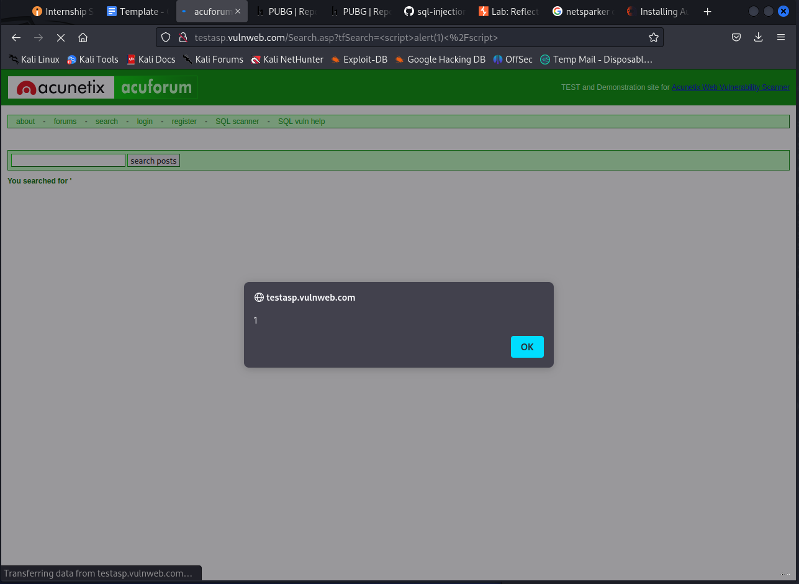
1st Vulnerability

Slide 6
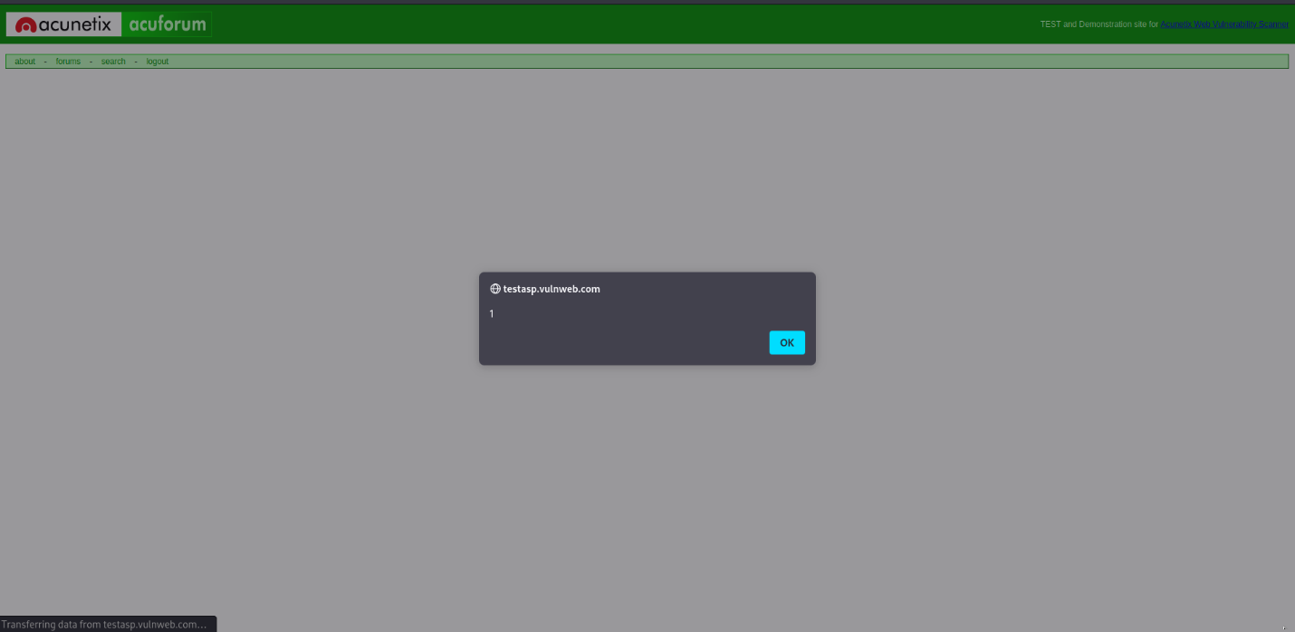
2nd Vulnerability

Slide 7
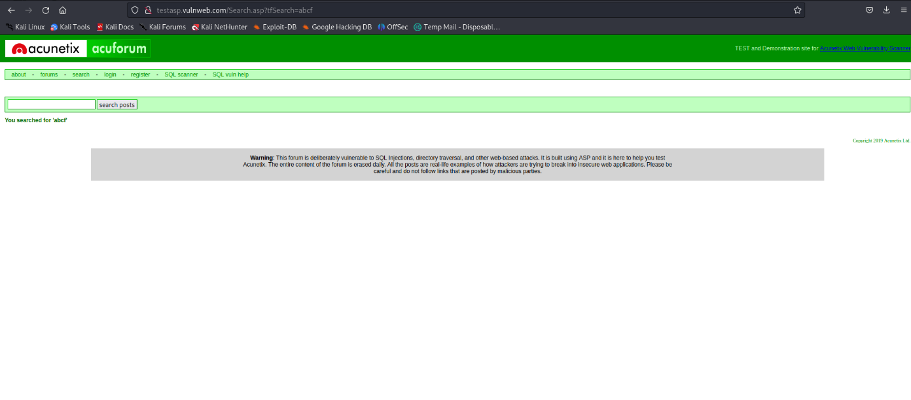
3rd Vulnerability

